Slide 2
BBM419 <Project Final Report>
Project Name | Report Date
Lighting Network for Blockchain | 03.01.2018
Student Number(s) | Student Name(s)
21328026 21328452 21327656 21693057 | Gülendam Buket Gündüz İrem Şireli Berat Göksel Atlı Muhammed Ali Karakurt
Supervisor(s) | Company Representative(s)
Adnan Özsoy

Slide 3
Project Overview
The goal of this project is applying the Bitcoin Blockchain Technology for a lighting network scenario.

Slide 4

Background
Bitcoin is a form of digital currency that is created by an unidentified person named Satoshi Nakamoto.
Blockchain is a distributed database that provides encrypted transaction. Constructed from a chain model, can not be broken, allowing to operate without being connected to a center, not possible to change the data on the blockchain.
Smart Contract is a computer protocol designed to facilitate, verify or implement a contract's negotiation or performance. Smart contracts allow you to make reliable transactions. These actions can be traced and can not be reversed.
Payment Channel is class of techniques designed to allow users to make multiple Bitcoin transactions without commiting all of the transactions to the Bitcoin blockchain.

Slide 5
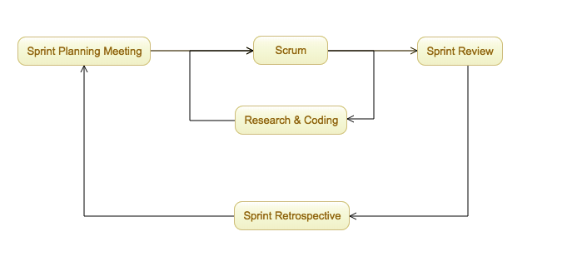
Method Followed

Slide 6
Technical Design
Our goal here is to reduce the transaction fee to zero. We want to be able to make unlimited paying bitcoin instantly without giving the extra fee. In doing so we used smart kontract and blockchain structures. The operations are done outside the blockchain and sent to the latest blockchain structure.

Slide 7
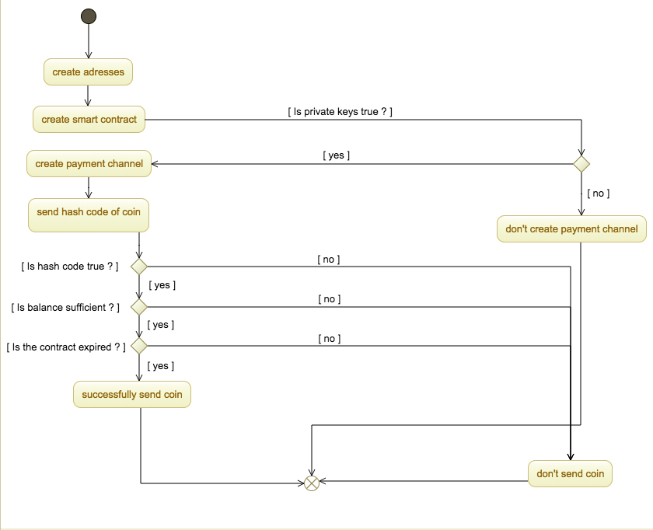
Operational Scenarios

Slide 8
Project Demo

Slide 9
<21328452 İrem Şireli >
I took the proposal report section. I specified the plan and the vision for the project, and I mentioned the risks we could encounter.
I did some research about payment process. I work with Göksel. We understand how to request payment using the payment protocol.
I did some research about Lightning Network.

Slide 10
<21327656 Berat Göksel ATLI>
Usually, we made every step together. In particular, I was responsible for the progress report 1 and applyinglighting network on the blockchain. I followed the process for completing the report correctly. We made work sharing reports. With İrem we implemented an applying ligthing network on the blockchain.

Slide 11
<21328026 Gülendam Buket Gündüz>
Project Final Report
Create Transaction
Implement a Simple Blockchain

Slide 12
<21693057- Muhammed Ali Karakurt>
I am in charge of Second Project Progress Report.
With the Buket we apply a simple Blockchain at the beginning of the project.
For the final project, I was responsible for the implementation, the results and contributions.

Slide 13
Evaluation of Results
We have four terms.
Blockchain System: We can use the blockchain system in regtest mode, and the reason why we work in regtest mode is financial concerns.
Set address: We can get bitcoin addresses and set these addresses on specific accounts, so we can create wallets.
Create transaction:We can make bitcoin exchanges between the accounts we have created. (ie transaction) and we can generate this transaction on the system.
Payment Channel : We can turn on and off a working payment channel by enacting serial processes outside the blockchain system, which are defined by the users, and the latest process being generated on the system.

Slide 14


Contributions to Industry and Economy
We provide less money and faster transactions for scenarios where a series of transactions are possible with the payment channel that we open at this point, and we also save a lot of time because we do not expect approval of every transaction. We can use this payment channel for systems that we can get online service.
Example = Spotify – Netflix
From our point of view, we think that the banking sector will not be needed because it is a well-established and fully functioning payment channel and its use is spreading among people, because the banking sector represents a reliable platform between the parties and the system itself provides this work for the payment channel.

Slide 15
Innovative Aspects
The innovation of the Lightning Network is the use of time­locked transactions and cryptographic nonces.
Game changing technology for commerce.

Slide 16
Self-Evaluation of Project Work
This project was a research project.
We have gained a lot of experience on this project.
If we did not have a limited time, we could complete the project.We gained much experience in the project and we can do better in the second term.

Slide 17

Thank You!
Thanks to Polo for not leaving us alone while our project meeting!

Slide 18
References
https://en.bitcoin.it/
https://bitcoin.org/
https://github.com/jgarzik/python-bitcoinrpc
https://github.com/petertodd/python-bitcoinlib
https://github.com/petertodd/checklocktimeverify-demos
https://www.forbes.com/sites/oliverherzfeld/2016/02/22/smart-contracts-may-create-significant-innovative-disruption/#6dfe35e9396a

